Slide 1
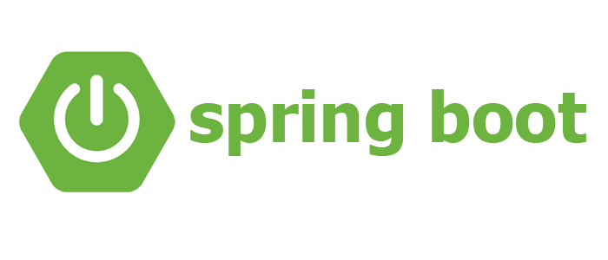
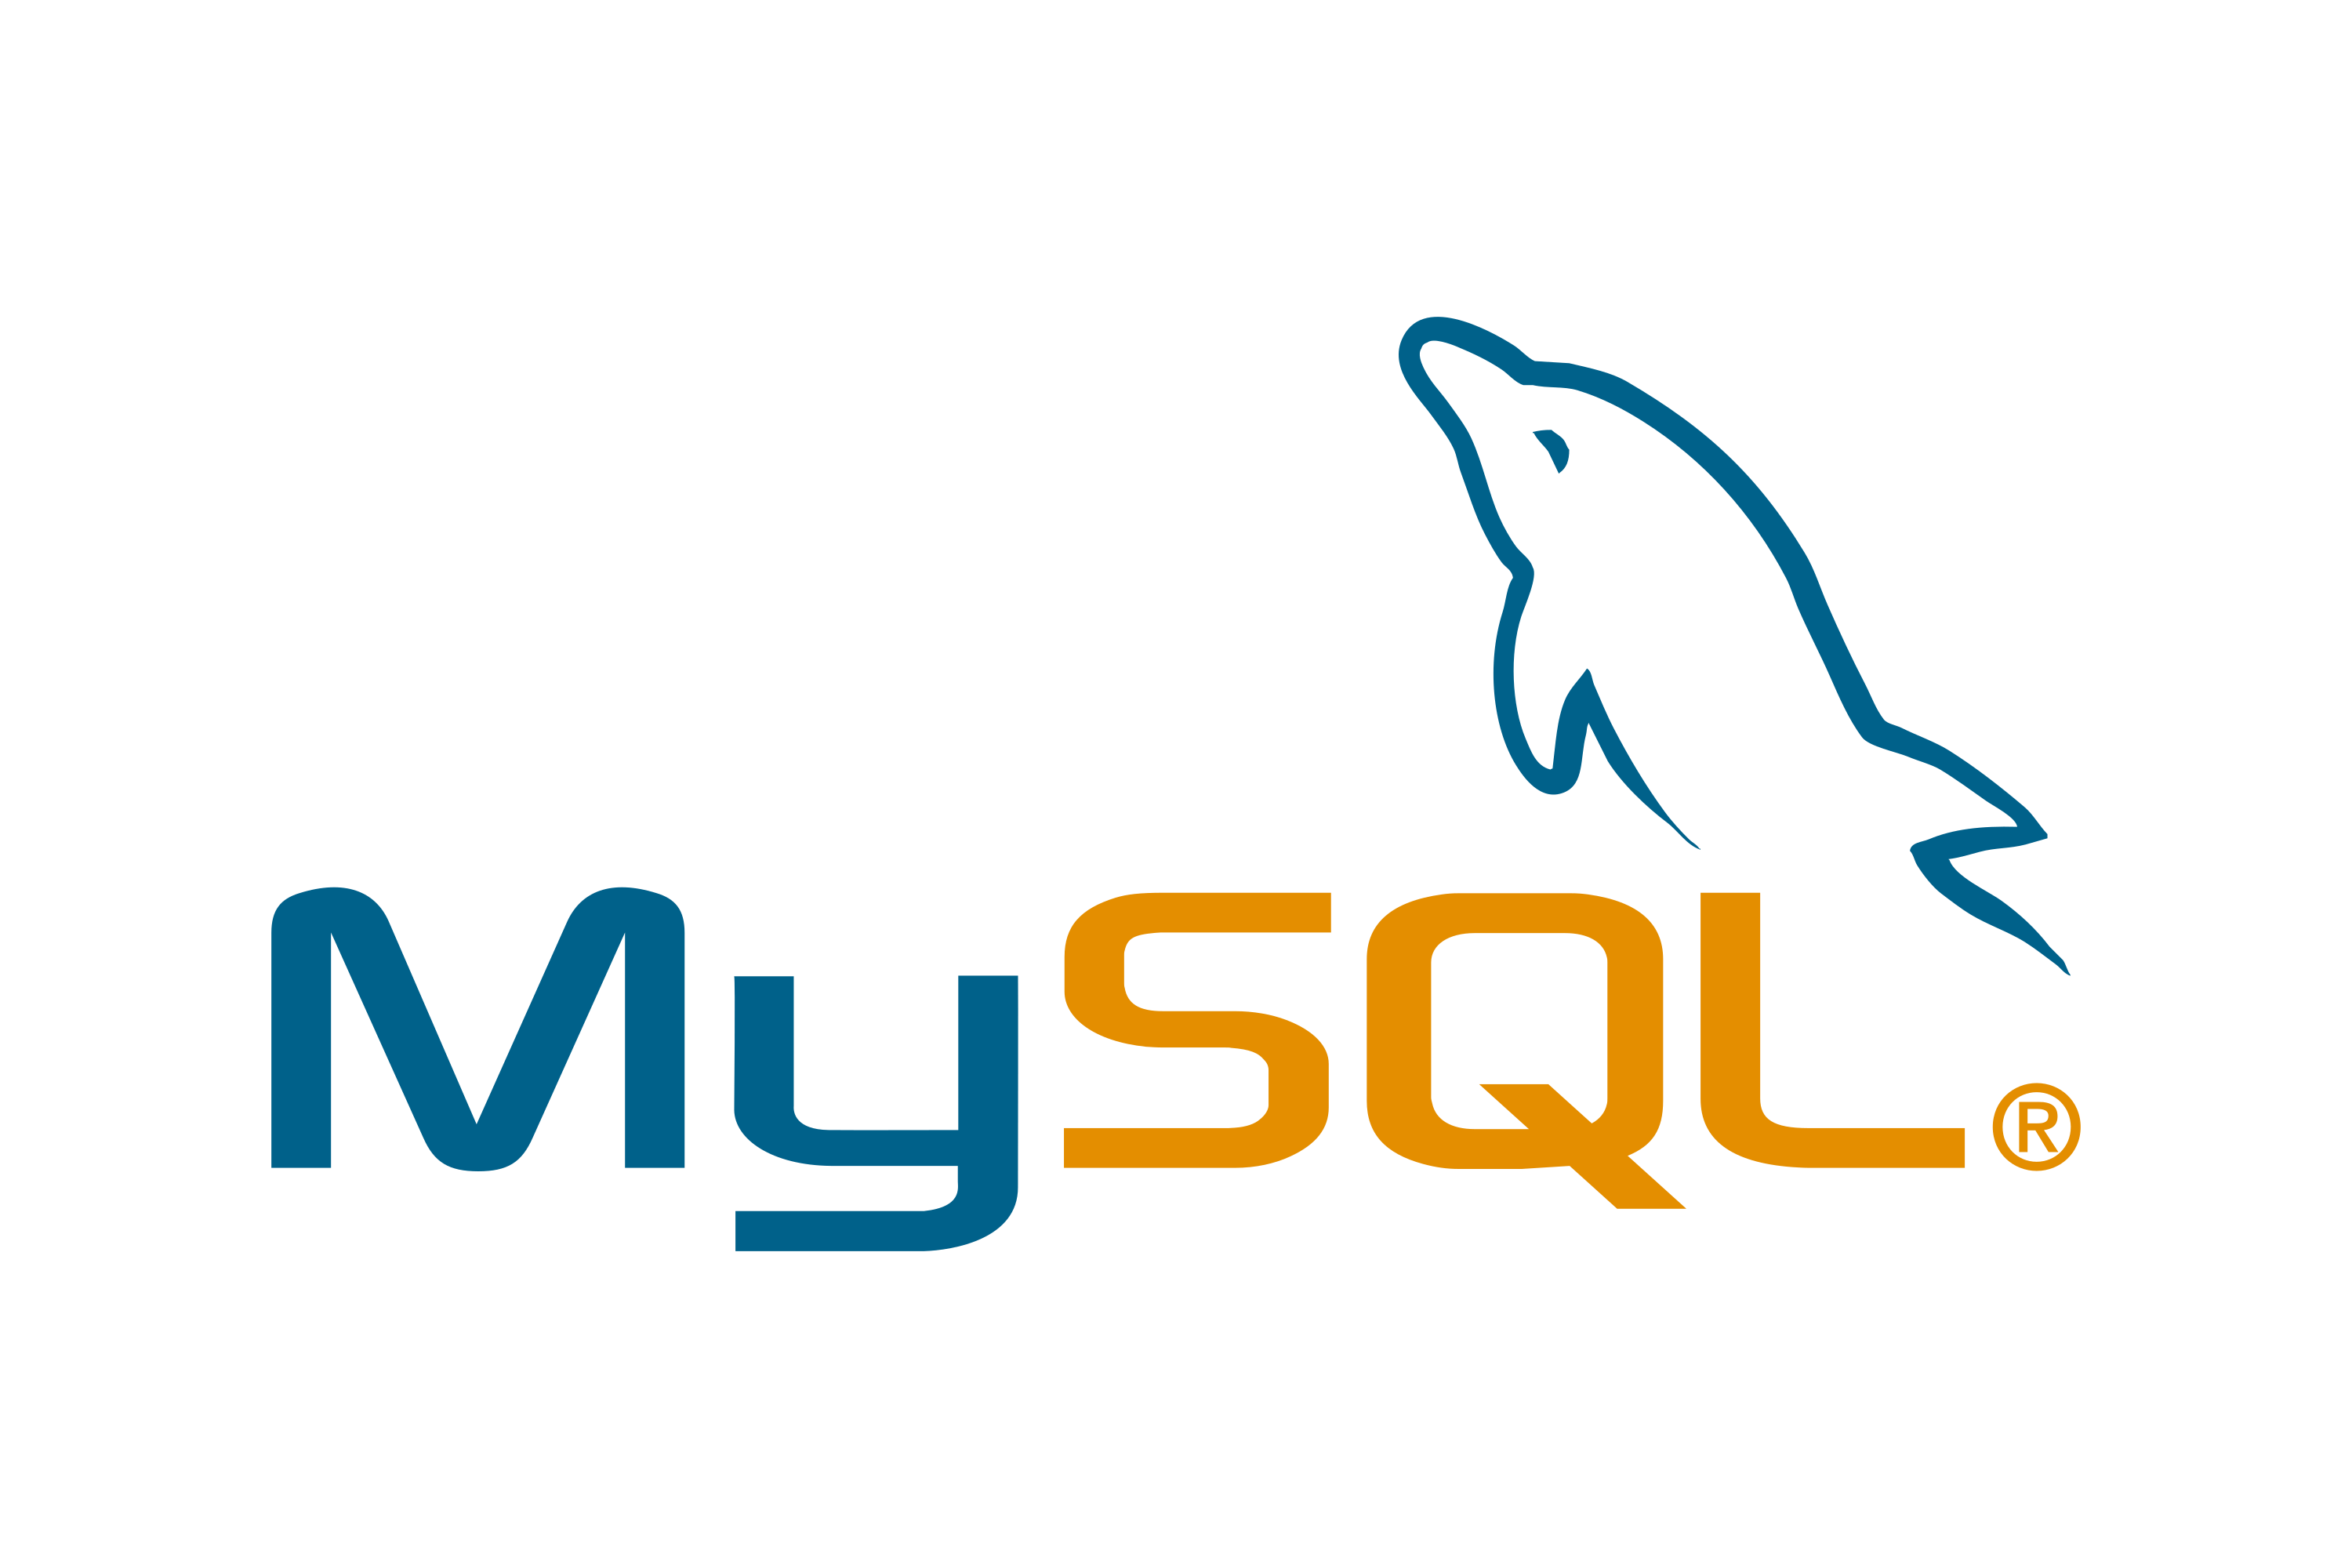




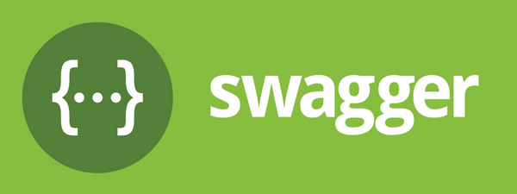



Free Backend Course using Spring Boot
(Blog Application)
/ Learn Code With Durgesh
/ Learn Code With Durgesh
/ Learn Code With Durgesh

Slide 2

What we will learn
Building real time Rest APIS for Blogging Application using Spring Boot, String Security , JWT , Spring Data JPA(Hibernate) and MySQL.
Creating Rest Endpoints
Complex Db structure (JPA Entities)
Role based Authentication
Handling Exceptions
Using DTO for Data Transfer
Swagger
/ Learn Code With Durgesh
/ Learn Code With Durgesh
/ Learn Code With Durgesh

Slide 3
What we will learn
How to add profiles for different envionments.
How to deploy spring boot in productions.
And much more…..
/ Learn Code With Durgesh
/ Learn Code With Durgesh
/ Learn Code With Durgesh

Slide 4
Prerequisite
Core java (oops , package , exception , lambda , stream api etc)
Basics of Spring Framework( Spring Core(DI) , JPA and MVC)
Spring Boot Basics
Basics of MySQL Database
STS IDE
/ Learn Code With Durgesh
/ Learn Code With Durgesh
/ Learn Code With Durgesh

Slide 5
How to learn for this ?
Code with me …………………
/ Learn Code With Durgesh
/ Learn Code With Durgesh
/ Learn Code With Durgesh

Slide 6
Client – Server Architecture
SERVER
CLIENT
Request
Android
Database
Desktop App
Data Exchange
JSON , XML
REST APIS
PostMan
Response
Web App
Web Server
/ Learn Code With Durgesh
/ Learn Code With Durgesh
/ Learn Code With Durgesh

Slide 7
What is REST ?
It is a software architectural style created by Roy Fielding in 2000 to guide the design of architecture for the web.
Format
json,xml
REST means :
Representational
State
Transfer
Data
Transfer data between two parties
/ Learn Code With Durgesh
/ Learn Code With Durgesh
/ Learn Code With Durgesh

Slide 8
REST Guidelines
Client Server Architecture
Stateless
Cacheable
Layered System
Unform Interface
Code on Demand( Optional )
/ Learn Code With Durgesh
/ Learn Code With Durgesh
/ Learn Code With Durgesh

Slide 9
REST Concepts
Resource
Sub-resource
URI
Http Methods
Http Response Code

Slide 10
Resource
Any thing that we want to expose to outside world, through our application
Book
User
Library Management System
Student
Teacher
Class
Subject
Student Management System
/ Learn Code With Durgesh
/ Learn Code With Durgesh
/ Learn Code With Durgesh

Slide 11
URI (Uniform Resource Identifier)
URI is used to identify resource.
GET | http://localhost:8282/students/ | Return the list of students
GET | http://localhost:8282/students/12 | Return the student of id 12
POST | http://localhost:8282/students/ | Create a new student
PUT | http://localhost:8282/students/20 | Update a student of id 20
DELETE | http://localhost:8282/students/2 | Delete a student of id 2
/ Learn Code With Durgesh
/ Learn Code With Durgesh
/ Learn Code With Durgesh

Slide 12
Sub-resource
Student-> Laptops
Method | http://localhost:8282/resource/{id}/sub-resource
GET | http://localhost:8282/students/12/laptops/ | Return the list of laptops of student 12
GET | http://localhost:8282/students/12/laptops/63 | Return the laptop of id 63 of student 12
Sub resource can not exists without resources
/ Learn Code With Durgesh
/ Learn Code With Durgesh
/ Learn Code With Durgesh

Slide 13
Http Request Methods
HTTP defines a set of request methods to indicate the desired action to be performed for a given resource
GET | http://localhost:8282/students/ | Return the list of students
GET | http://localhost:8282/students/12 | Return the student of id 12
POST | http://localhost:8282/students/ | Create a new student
PUT | http://localhost:8282/students/20 | Update a student of id 20
DELETE | http://localhost:8282/students/2 | Delete a student of id 2
Http Methods
/ Learn Code With Durgesh
/ Learn Code With Durgesh
/ Learn Code With Durgesh

Slide 14
Http Response Codes
HTTP response status codes indicate whether a specific HTTP request has been successfully completed.
200 OK | Request is successful
201 Created | Request is successful and new resource is created
401 Unauthorized | Authentication is required for resource
404 Not Found | Resource Not Found
500 Internal Server Error | Error occurred on server and request can not fulfilled.
Http Response codes
/ Learn Code With Durgesh
/ Learn Code With Durgesh
/ Learn Code With Durgesh

Slide 15
What we are going to build: Client Requirement
Client wants blogging application where he/she can write blogs and articles .
user can comment on the blogs/article .
We have to build simple Blogging Application:-
User should create, update, delete and list posts.
User should add, update, delete comments on posts.
Categories the posts according to categories.
New user should able to Register on our application
User should able to login to our application.
Post include one picture too.
/ Learn Code With Durgesh
/ Learn Code With Durgesh
/ Learn Code With Durgesh

Slide 16
What we are going to build: Some technical terms.
Proper Login and Register API.
Posts API includes Pagination and Sorting.
Proper user input validation handling
Proper exception handling
Role based authentication-role based security with apis
JSW based authentication
Document all rest apis so that consumer can easy understand.
Deploy the backend application on any cloud platform.
/ Learn Code With Durgesh
/ Learn Code With Durgesh
/ Learn Code With Durgesh

Slide 17
What are the technologies and tools we are going use ?
Framework: Spring Boot Java Framework.
Java 8+
Maven
STS
Apache Tomcat
Spring core, Spring security(jwt) , Spring data JPA(Hibernate) et.c
MySQL Database.
Postman Rest Client
Swagger
AWS- EC2
/ Learn Code With Durgesh
/ Learn Code With Durgesh
/ Learn Code With Durgesh

Slide 18
Resources for Blogging Application
USER
CATEGORY
POST
COMMENTS
Resource for our application
/ Learn Code With Durgesh
/ Learn Code With Durgesh
/ Learn Code With Durgesh

Slide 19
Best architecture while using Spring Boot for backend.
API Layers
Business Logic
Dao Layer
Controllers
Services
Repositories
Database
Postman
(Client)
Spring Boot APP
/ Learn Code With Durgesh
/ Learn Code With Durgesh
/ Learn Code With Durgesh

Slide 20
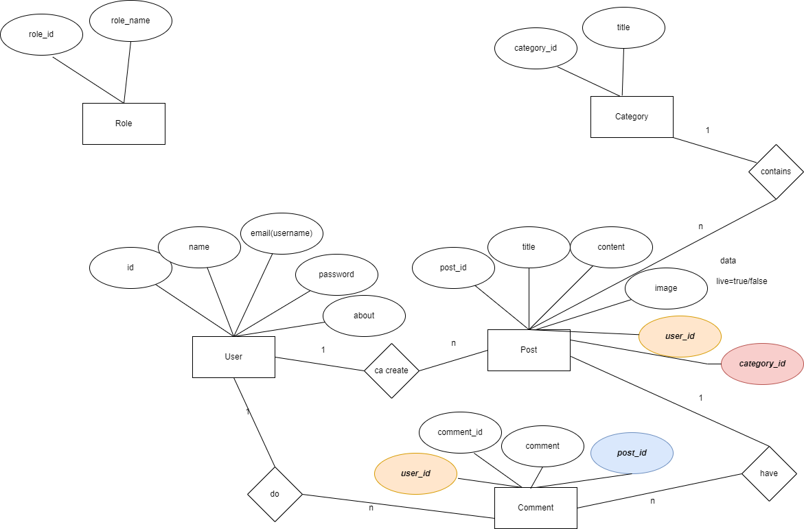

Slide 21
Creating User API
METHOD | URL | INFO
POST | /users | Create New User
PUT | /users/{userId} | Update the user with given id Request contain new user information
GET | /users | Get all users
GET | /users/{userId} | Get single user with given userid
DELETE | /users/{userId} | Delete the user with given userid
/ Learn Code With Durgesh
/ Learn Code With Durgesh
/ Learn Code With Durgesh

Slide 22
Basics of Validation
Java bean is validated with JSR 380 known as Bean Validation 2.0
JSR 380 is specification for the Java API for bean validation . Properties of bean meet the specific criteria .
For validation different annotations is used like @NotNull, @Min, @Size etc.
Hibernate Validator is a implementation of validation api.

Slide 23
Important Annotations for validations
@NotNull
@Email
@Size
@Min
@Max
@NotEmpty
Etc……………

Slide 24
How to use :
Spring boot provides support for Hibernate Validator.
<dependency>
<groupId>org.springframework.boot</groupId>
<artifactId>spring-boot-starter-validation</artifactId>
<version>2.6.6</version>
</dependency>

Slide 25
Securing Rest APIS

Slide 26
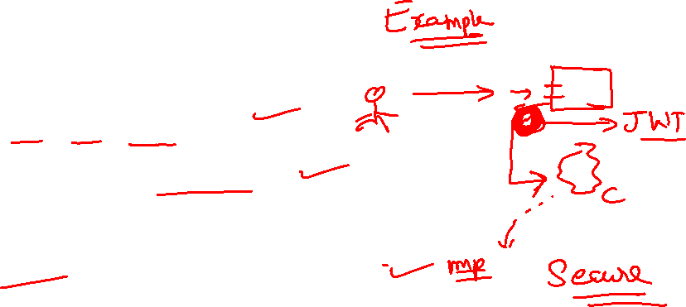
JWT Authentication
JWT stands for Json Web Token.
JWT is mostly used for securing Rest APIS.
Best way to communicate security between client and server securely.
JWT follows a stateless authentication mechanism.

Slide 27
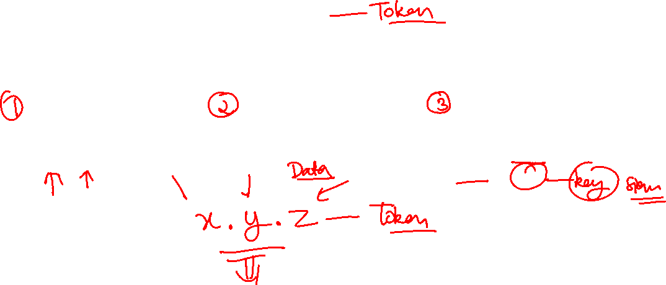
Architecture of JWT
JWT
Header
Payload
Signature
Algo+Type
Information about Claims
encoded header + encoded payload +key

Slide 28
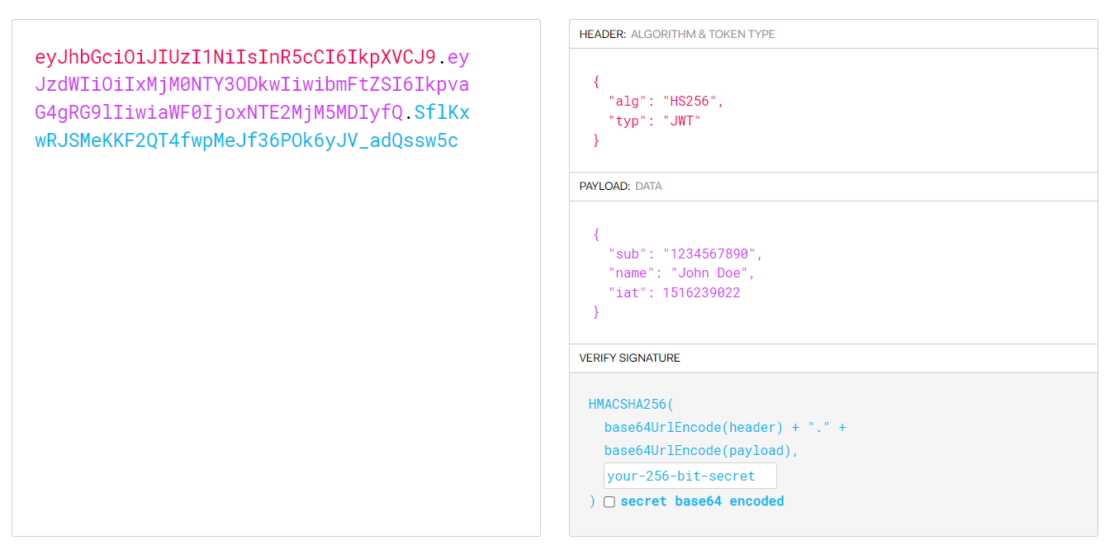
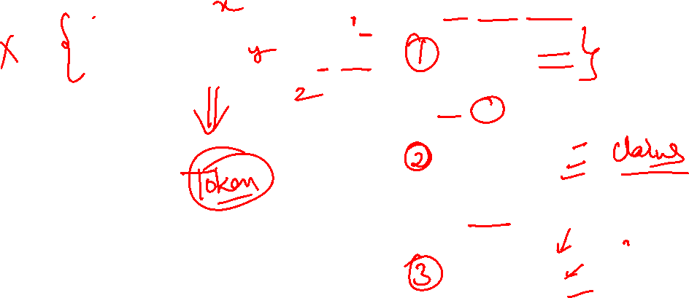
Architecture of JWT

Slide 29
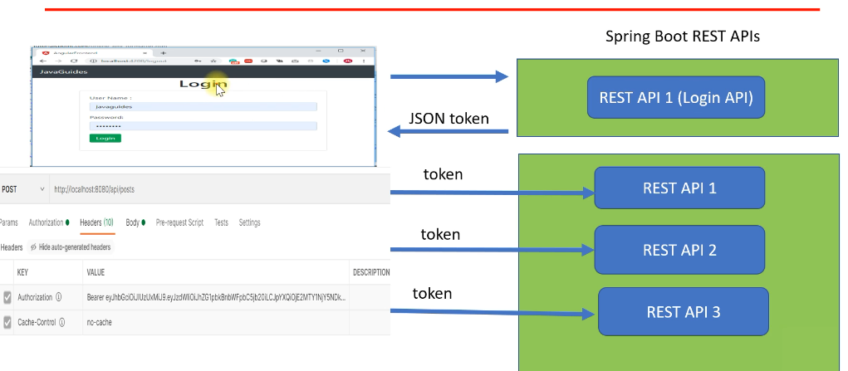
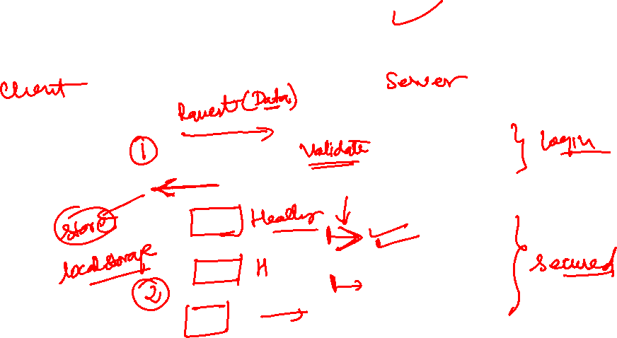
How to use JWT with Spring Security

Slide 30
Steps to Implement JWT
Add dependency(io.jsonwebtoken)
Create JWT authenticationEntryPoint implements AuthenticationEntryPoint
Create JWTTokenHelper
JwtAuthenticationFilter extends OnceRequestFilter
Get jwt token from request
Validate token
Get user from token
Load user associated with token
Set spring security
Create JwtAuthResponse
Configure JWT in spring security config
Create login api to return token
Test the application.

Slide 31
Documenting APIS

Slide 32
Deploying Spring Boot App on AWS

